Slide 1
Data Structures and Algorithms IICT-6005
Lesson 11 – Merge Sort

Slide 2
Lesson Content
The Sorting Problem
Different Sorting Algorithms
Efficient and Inefficient Sorts
Merge Sort Algorithm
Analysis of Merge Sort

Slide 3
The Sorting Problem
The sorting problem arises when a sequence of elements needs to be ordered; often in ascending or descending order.
Example :
INPUT: a sequence of n numbers (10, 6, 1, 8, 13, 2) OUTPUT: a permutation (reordering) of the input sequence (1,2 , 6, 8, 10, 13) , such that n₀ < n₁ < n₂ < n_{n-1}
A sorting algorithm is correct if for every possible instance of the input, it will return the correct output in finite time.
Note: When no sorting order is specified ascending order is assumed by default

Slide 4
The Sorting Problem
What sorting algorithms are available?
Several sorting algorithms exist; the sorting problem is a very popular problem in data structure and algorithms and various efforts have been made to create algorithms that take up less time and/or memory to solve this problem.
Examples :
 | Best Case | Typical Case | Worst Case | Space Complexity
Bubble Sort | O(n) | O(n²) | O(n²) | O(1)
Merge Sort | O(n log n) | O(n log n) | O(n log n) | O(n)
Quick Sort | O(n log n) | O(n log n) | O(n²) | O(log n)
Bucket Sort | O(n) | O(n) | O(n²) | O(n)
Heap Sort | O(n log n) | O(n log n) | O(n log n) | O(1)
Notes:
Source : https://medium.com/@george.seif94/a-tour-of-the-top-5-sorting-algorithms-with-python-code-43ea9aa02889

Slide 5
Efficient and Inefficient Sorts
As one can see, not all sorting algorithms were created equally!
Some are very slow but make good use of memory e.g. Bubble Sort
Some are fast but require more memory e.g. Merge Sort
Some have it all e.g. Heap Sort
Examples :
 | Best Case | Typical Case | Worst Case | Space Complexity
Bubble Sort | O(n) | O(n²) | O(n²) | O(1)
Merge Sort | O(n log n) | O(n log n) | O(n log n) | O(n)
Quick Sort | O(n log n) | O(n log n) | O(n²) | O(log n)
Bucket Sort | O(n) | O(n) | O(n²) | O(n)
Heap Sort | O(n log n) | O(n log n) | O(n log n) | O(1)
Notes:
Source : https://medium.com/@george.seif94/a-tour-of-the-top-5-sorting-algorithms-with-python-code-43ea9aa02889

Slide 6
Merge Sort
The Merge Sort is a “divide and conquer” algorithm.
It works on the principle that sorting small arrays individually and then aggregating their results is simpler that trying to sort a large array all at once.
Think of a pack of cards…what is easiest?
Trying to sort all 52cards at one go in one single deck
OR
Splitting the cards into 4 decks (♣ , ♠, ♥, ♢)
Sorting each deck individually
Putting all the decks back together

Slide 7
Merge Sort
The Merge Sort works on a similar principle
The simplest implementation makes use of recursion:
Divide the list in two,
Sort each of these lists individually (using Merge Sort),
Merge the sorted lists.
In this case, the Base Case for our recursion is reached when we have an array of size 0 or 1, as these are automatically sorted.

Slide 8
Merge Sort
8
7
4
6
2
5
8
7
4
6
2
5
Left Array
Right Array

Slide 9
Merge Sort
8
7
4
6
2
5
8
7
4
Left Array
Right Array

Slide 10
Merge Sort
8
7
4
8
7
At this point we have 2 lists of size 1 meaning that they are automatically sorted
Therefore we can start to merge our arrays
Left Array
Right Array

Slide 11
Merge Operation
The Merge operation takes two sorted lists and merges both sorted lists into one large sorted list.
It compares the smallest in each list and places it in an other array which will include the final output

Slide 12
Merging two sorted lists
Action: Start with 2 sorted lists.
4
7
8
L1=
2
6
5
L2=

Slide 13
Merging two sorted lists
Action:
Compare the smallest element from both lists.
4
7
8
L1=
2
6
5
L2=

Slide 14
Merging two sorted lists
Action:
Select the smallest item and place it in the output array
L1=
4
7
8
L2=
2
6
5
Output =
2

Slide 15
Merging two sorted lists
Action:
Repeat until all elements from one of the arrays have been copied into the output array
L1=
4
7
8
L2=
2
6
5
Output =
2
4
6
5

Slide 16
Merging two sorted lists
Action:
Now that all elements from L2 have been copied in the output array, We can copy all the remaining elements from L1 into the output array.
Since the lists are sorted the elements form L1 will be added to the output array in ascending order
L1=
4
7
8
L2=
2
6
5
Output =
2
4
6
5
7
8

Slide 17
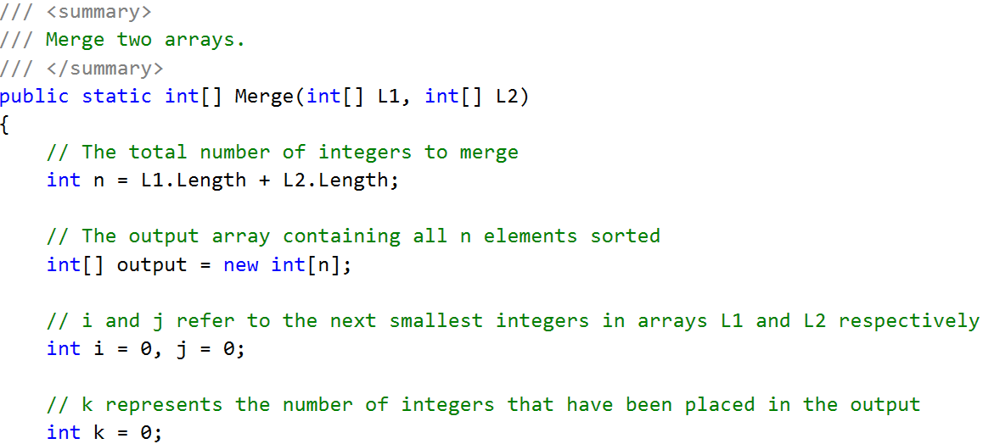
The Merge Operation

Slide 18
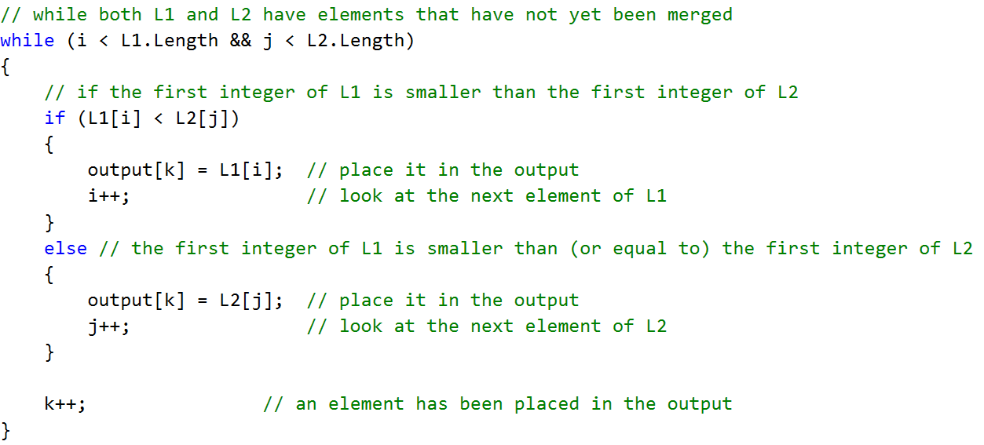
The Merge Operation

Slide 19
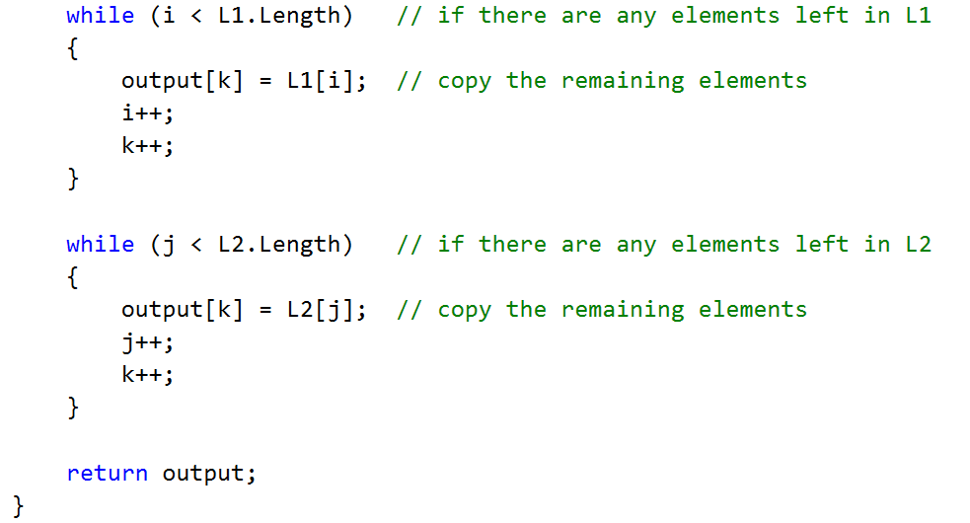
The Merge Operation

Slide 20
Merge Operations in Merge Sort
The Merge Operation will be used in Merge Sort to merge together sorted arrays after these have been broken up into smaller sub-arrays.
Remember
8
7
4
At this point we have 2 lists of size 1 meaning that they are automatically sorted
Therefore we can start to merge our arrays
8
7
Left Array
Right Array
20

Slide 21
Merge Sort
8
7
4
Left Array
Right Array
Merge
7
8

Slide 22
Merge Sort
7
8
4
Left Array
Right Array
Merge
Now that the left side of the original array has been sorted we can sort the right side in the same way
4
7
8

Slide 23
Merge Sort
7
8
4
6
2
5
Left Array
Right Array
4
7
8
6
2
Left Array
Right Array

Slide 24
Merge Sort
7
8
4
6
2
5
Left Array
Right Array
Merge
4
7
8
2
6

Slide 25
Merge Sort
7
8
4
2
6
5
Left Array
Right Array
Merge
4
7
8
2
5
6

Slide 26
Merge Sort
4
7
8
2
5
6
Left Array
Right Array
Merge
2
4
5
6
7
8

Slide 27
Analysis of Merge Sort
As already seen, Merge sort takes O(n log n) time for all its cases i.e. Best Case, Typical Case and Worst Case all take O(n log n) time.
This makes Merge sort a very efficient sorting algorithm as log-linear time is considered as quite fast.
The drawback of the Merge Sort is it’s space complexity i.e. the amount of memory it requires as the sequence of elements to sort grows.
Merge sort has O(n) i.e. linear space complexity, which is amongst the worse for sorting algorithms!

Slide 28
Analysis of Merge Sort
Merge sort has such poor space complexity due to the amount of arrays needed to carry out the merge operations.
In order to sort one array you need to create another 3 arrays!
2 arrays to split the original array in half (sort each half individually)
1 more array to merge the 2 sorted arrays into the final results.
Therefore Merge Sort sacrifices memory in order to gain speed.
As long as our hardware requirements allow us to sacrifice memory this should not be problem but if our memory resources are limited then we should think twice about using Merge Sort.

Slide 29
Summary
The Sorting Problem
Different Sorting Algorithms
Efficient and Inefficient Sorts
Merge Sort Algorithm
Analysis of Merge Sort

Slide 30
End of lesson
Any questions?

